Slide 1
QA Metrics & Reporting
Learn about different QA Metrics and Track them efficiently

Slide 2
What are QA Metrics
QA Metrics are quantitative indicators used to measure:
The quality of your product
The efficiency of your testing
The status of bugs and defects
Overall testing productivity

Slide 3
Essential Metrics for the QA process
QA metrics are measurable standards used to track and assess the quality of software during the development process.
metrics give teams the clarity to spot risks early, improve workflows, and deliver higher-quality software with confidence.
provide data-driven insights into the effectiveness of testing efforts, identify areas for improvement, and help ensure the final product meets quality standards

Slide 4
Why are Software Quality Metrics important
Ensure Product Quality: They help verify that the software meets functional and non-functional requirements.
Drive Continuous Improvement: Metrics highlight inefficiencies and areas requiring attention, enabling ongoing process optimization.
Enable Data-Driven Decisions: Teams can make informed choices instead of relying on intuition or guesswork.
Track Progress & Performance: Monitor project health, team productivity, and testing effectiveness over time.
While others are
Detect Issues Early
Support compliance & standards
Improve customer satisfaction

Slide 5
Classification Of Metrics
metrics are identified as absolute (quantitative) or derived (qualitative), they are further classified based on what aspect they measure.
Product Metrics: Measure the quality and characteristics of the software product itself (for example, defect density, customer-reported defects).
Process Metrics: Measure the effectiveness and efficiency of the QA and development processes (for example, mean time to repair, bug reopen rate).
Project Metrics: Measure project progress, timelines, resource usage, and costs (for example, time to market, cost of quality).

Slide 6
Top Metrics – Product Quality
1. Defect Density : Measures how many defects are found in a given size of software. It helps assess overall code quality and maintainability.
How to Calculate: (Total Defects) ÷ (Size of Software, e.g., Lines of Code or Function Points)
2. Defect Leakage: Tracks how many defects escape into production after testing. It helps evaluate the effectiveness of testing efforts.
How to Calculate: (Defects after release ÷ Total defects found during testing) × 100
3. Test Coverage : Measures how much of the codebase or functionality has been tested. It helps ensure comprehensive validation of features and reduces risk.
How to Calculate: (Number of items tested ÷ Total number of items) × 100

Slide 7
Continue
Requirements Coverage
Severity Index
Priority Index
Escaped Defects

Slide 8
Process Quality Metrics
1. Test Case Pass Rate : Indicates the percentage of test cases that pass successfully. It helps gauge the stability of the application at a given time.
How to Calculate: (Test Cases Passed ÷ Total Test Cases Executed) × 100
2. First-Time Pass Rate: Shows the percentage of test cases that pass in their first execution. It reflects the readiness and quality of the software build.
How to Calculate: (Test Cases Passed First Attempt ÷ Total Test Cases Executed) × 100
3. Automation Coverage: Tracks the proportion of test cases that are automated. It helps measure test efficiency, repeatability, and scalability.
How to Calculate: (Automated Test Cases ÷ Total Test Cases) × 100

Slide 9
Continue
13. Bug Reopen Rate : Measures how often bugs thought to be fixed are reopened. It helps assess the quality of fixes and the reliability of defect resolution.
14. Mean Time to Detect (MTTD): Shows how quickly defects are detected after introduction. It helps minimize the time defects remain hidden and reduces potential damage.
While others are
Mean Time to Repair (MTTR)
Test Design Efficiency
Build Failure Rate

Slide 10
Project Metrics
Test Execution Progress : Tracks how much of the planned testing has been completed. It helps monitor project testing status and detect schedule risks early.
How to Calculate: (Test Cases Executed ÷ Test Cases Planned) × 100
Time to Market
Measures the total time taken from project start to product launch. It is critical for maintaining competitiveness and responding to market needs.
How to Calculate: (Release Date) – (Project Start Date)
Cost of Quality (CoQ) : Represents the total investment needed to achieve and maintain product quality. It helps balance cost management with quality outcomes.

Slide 11
Best Practices
Define Clear Objectives: Know what you want to measure, like defect density, test coverage, or code maintainability and why.
Align Metrics with Business Goals: Ensure metrics reflect what matters most to stakeholders, such as reliability, performance, or user satisfaction.
Use a Balanced Set of Metrics: Combine process, product, and people metrics for a holistic view.
Avoid Vanity Metrics: Don’t rely on numbers that look good but offer little insight (for example, total test cases written without measuring pass/fail or coverage).
Automate Data Collection: Leverage tools for CI/CD, test automation, and code analysis to gather consistent, real-time data.

Slide 12
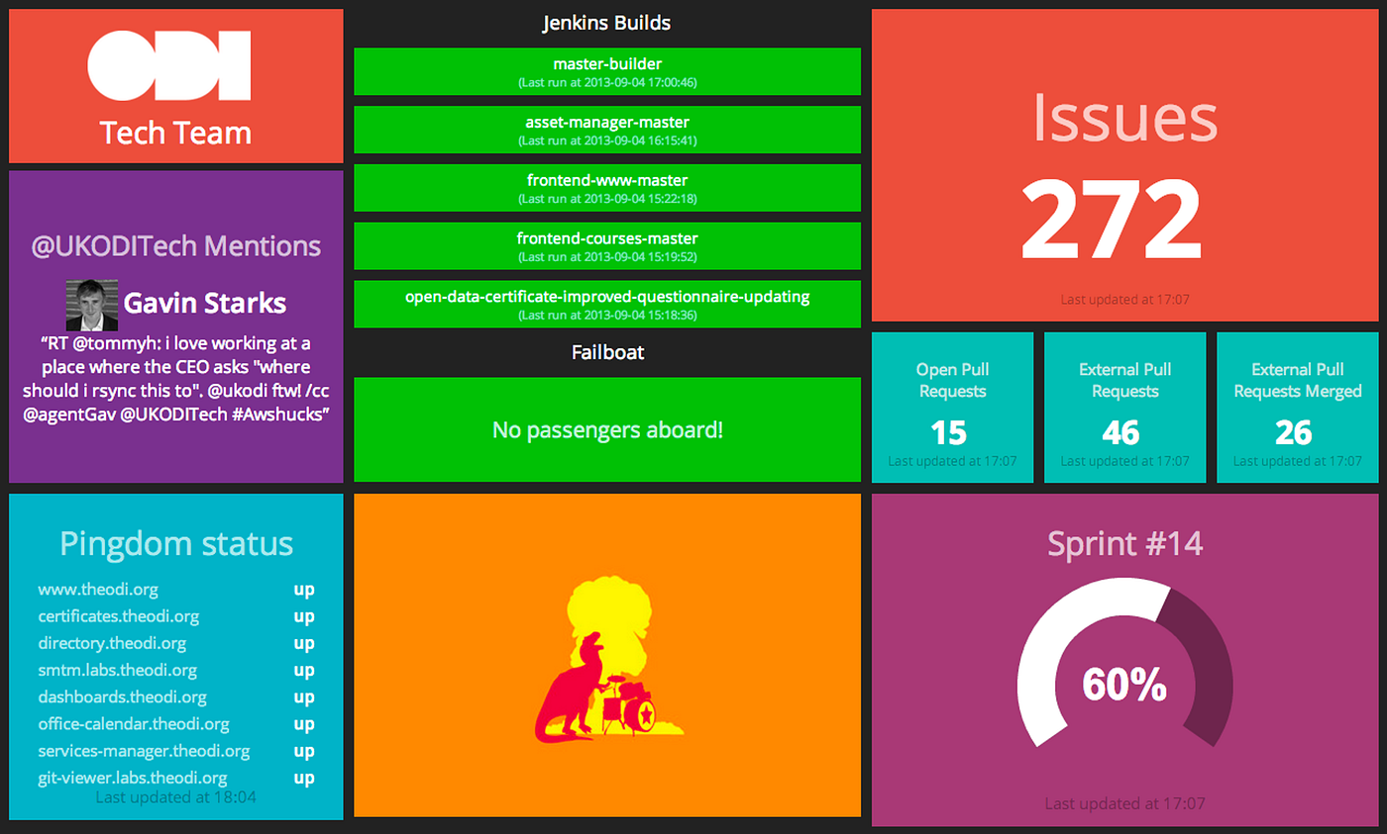
Dashboard reporting and tools
QA metrics dashboards and reporting tools provide a visual overview of software quality, tracking key performance indicators (KPIs) to monitor testing progress and identify potential issues.
These tools help teams make data-driven decisions, improve software quality, and streamline the development cycle.

Slide 13
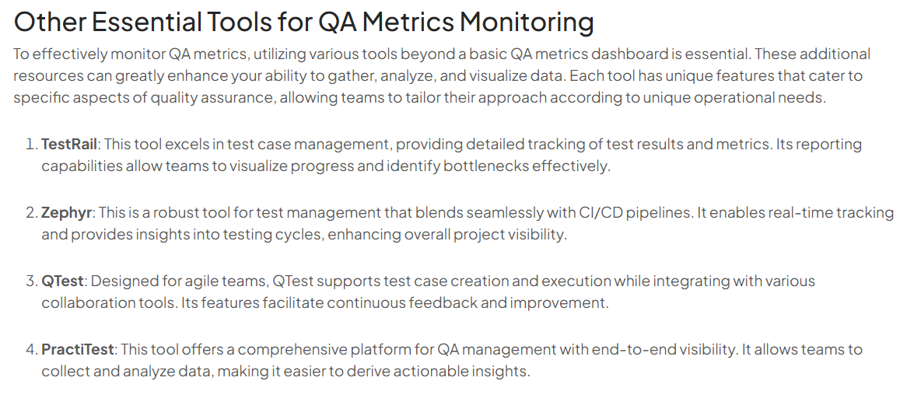
Tools
Manual Dashboard using Excel
Google Data Studio
JIRA Dashboard (Atlassian Cloud)

Slide 14
Let’s Do Something Interesting - how Test Coverage using pytest + coverage.py
Write a small Python app (grade.py)
Write unit tests (test_grade.py)
Run tests with pytest
Generate a test coverage report (terminal + HTML)Interpret results visually
Comnands
Step 1: Install Tools `pip install pytest coverage`
Step 2 : Run Tests with Coverage : `coverage run -m pytest`
Step 3: Show report in terminal : `coverage report –m`
Step 4: Generate Visual Report : `coverage html`

Slide 15
What we have done
Concept | Explanation
Test Coverage | How much of your code is tested
coverage.py | Measures coverage while tests run
HTML Report | Easy-to-read visual result
Pytest + Coverage | Combo for modern QA/testing workflows
Notes:
Coverage.py is a tool for measuring code coverage of Python programs. It monitors your program, noting which parts of the code have been executed, then analyzes the source to identify code that could have been executed but was not.

Slide 16
Dashboards or Reporting Tools Demo
how how to track, visualize, and report testing progress using simple but effective dashboards.
Creating a manual test execution dashboard in Excel/Google Sheets
Showing real metrics like:
Test case pass/fail rate
Execution progress %
Defect summary
Tester-wise productivity

